Slide 1
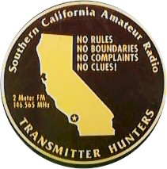
No Rules
No Boundaries
No Complaints
“All Day”
Southern California
Transmitter Hunting
146.565 MHz
Fourth Saturday
Pasadena Amateur Radio Club
February 24, 2026, 7:00 p.m.
v. 4
J. Scott Bovitz
N6MI (n6mi.com)
bovitz@bovitz.com

Slide 2
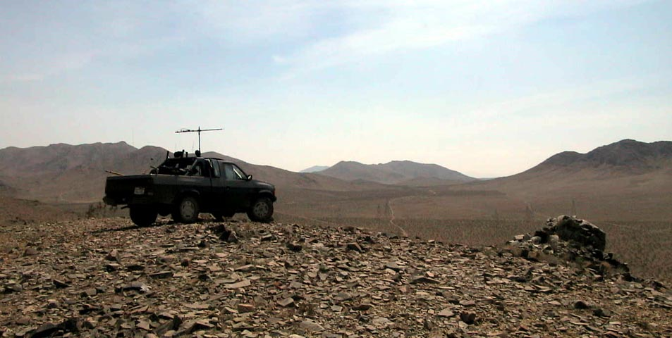

Slide 3
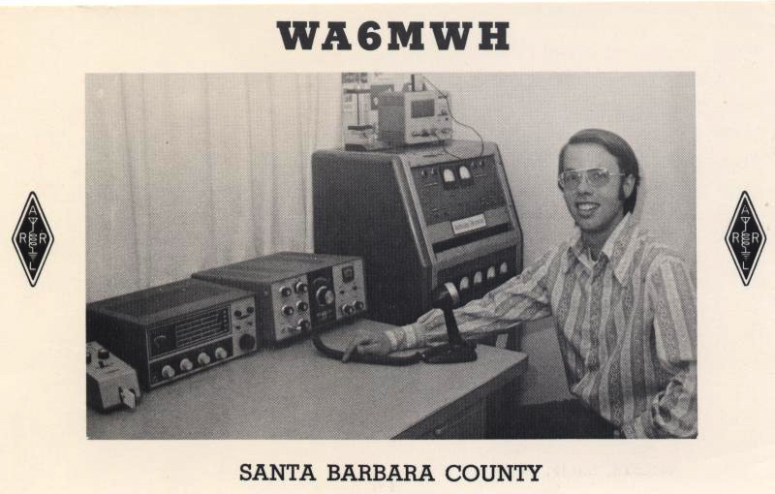
1973

Slide 4
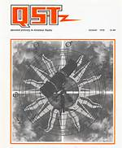
QST – quote from 1976
http://www.arrl.org/arrlletter&issue=current (Sep. 1, 2014):
“Hidden transmitter hunts, also known as radio foxhunting, had been very popular in Europe for some time, and the sport started catching on in the US, mostly involving the use of 2 meter FM.”

Slide 5
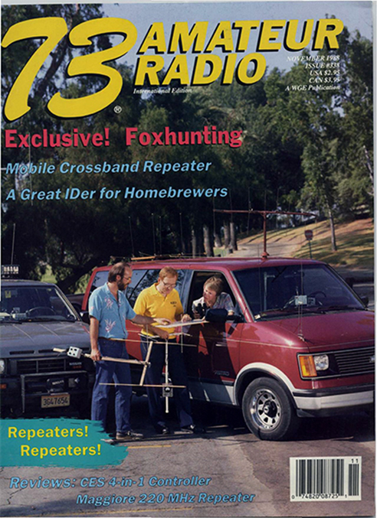
1988
K0OV, Joe
http://homingin.com

Slide 6
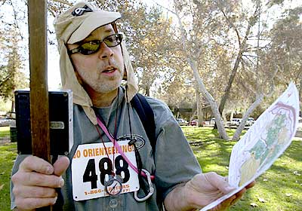
2004
LA
Times
article
on
t-hunting

Slide 7
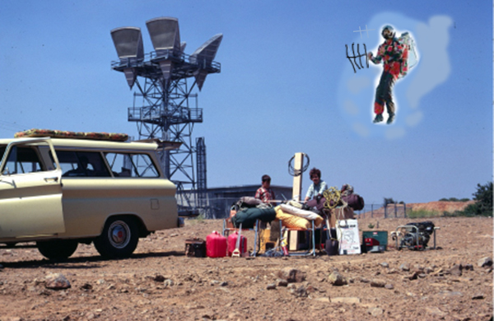
1960s -- all day t-hunts begin

Slide 8
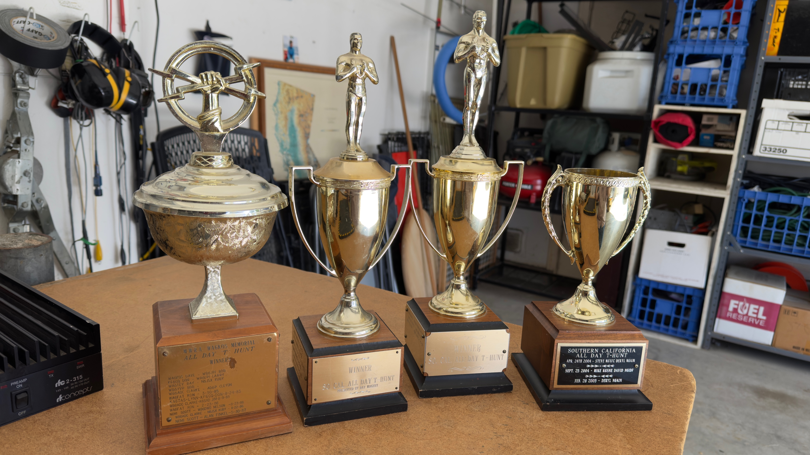

Slide 9
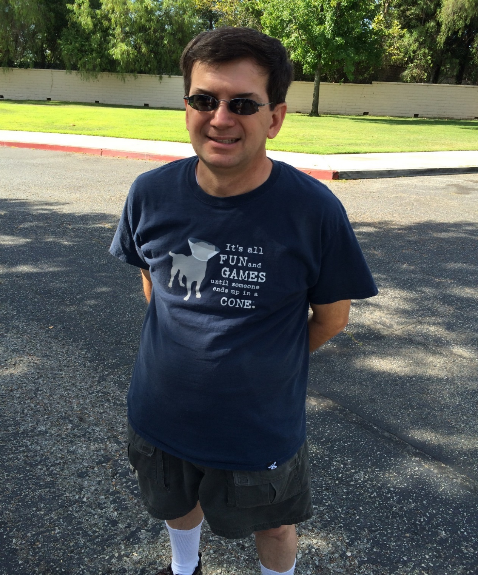
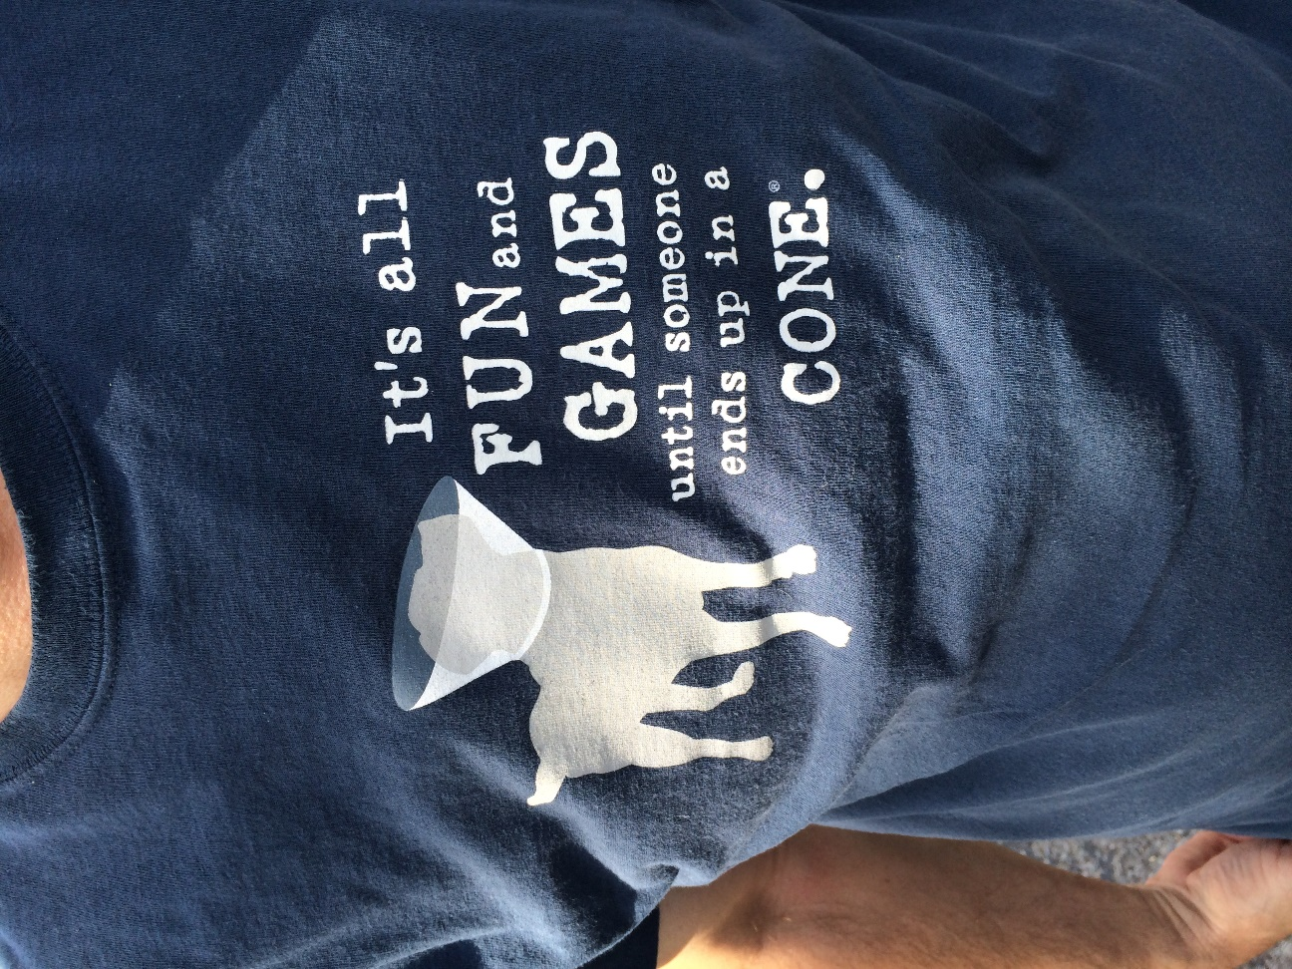
N6EKS

Slide 10
Radio installations

Slide 11
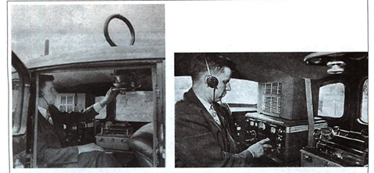
1933

Slide 12
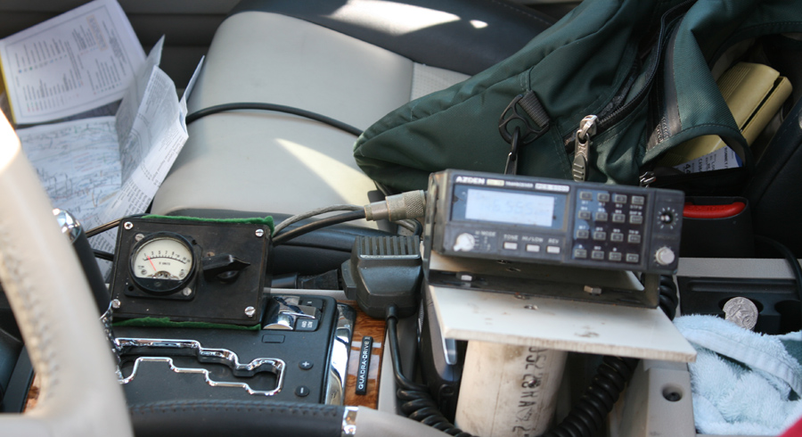
1998

Slide 13
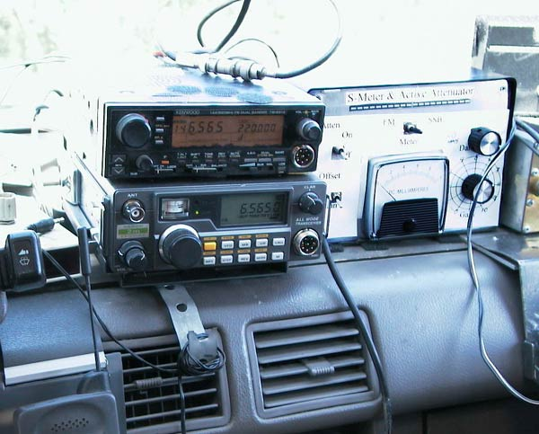
2000

Slide 14
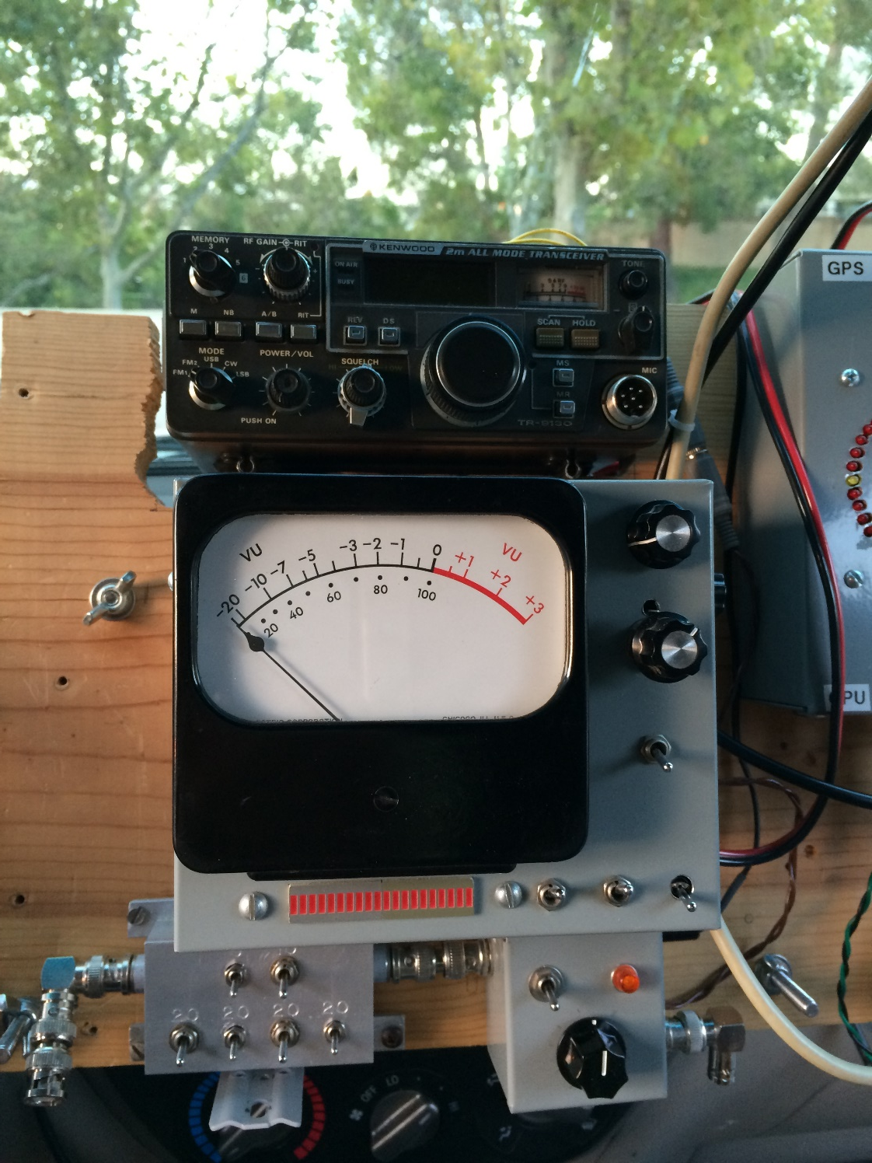
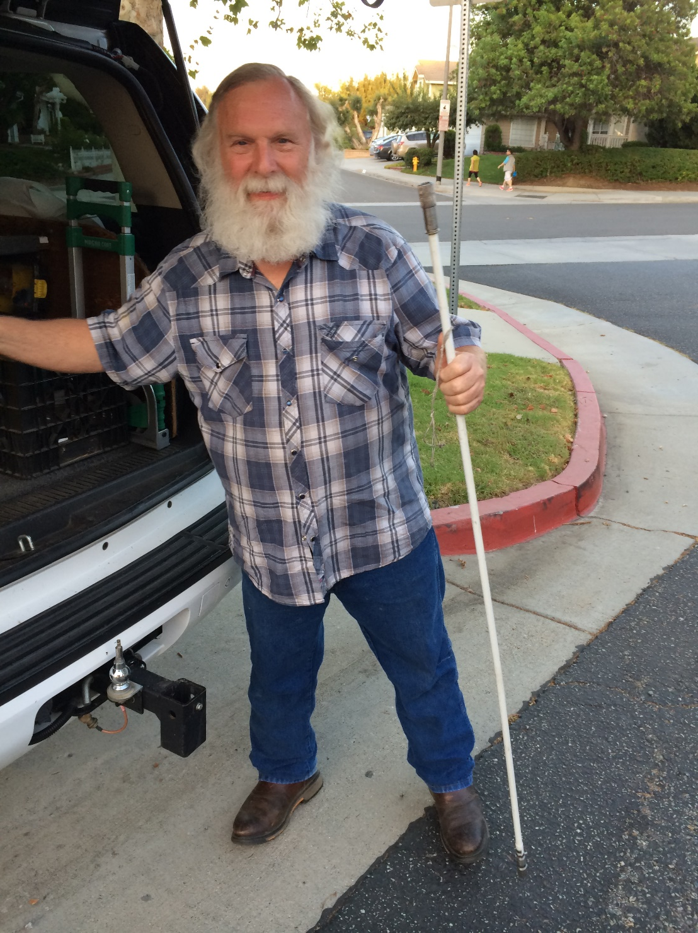
WA6CYY
Ron

Slide 15
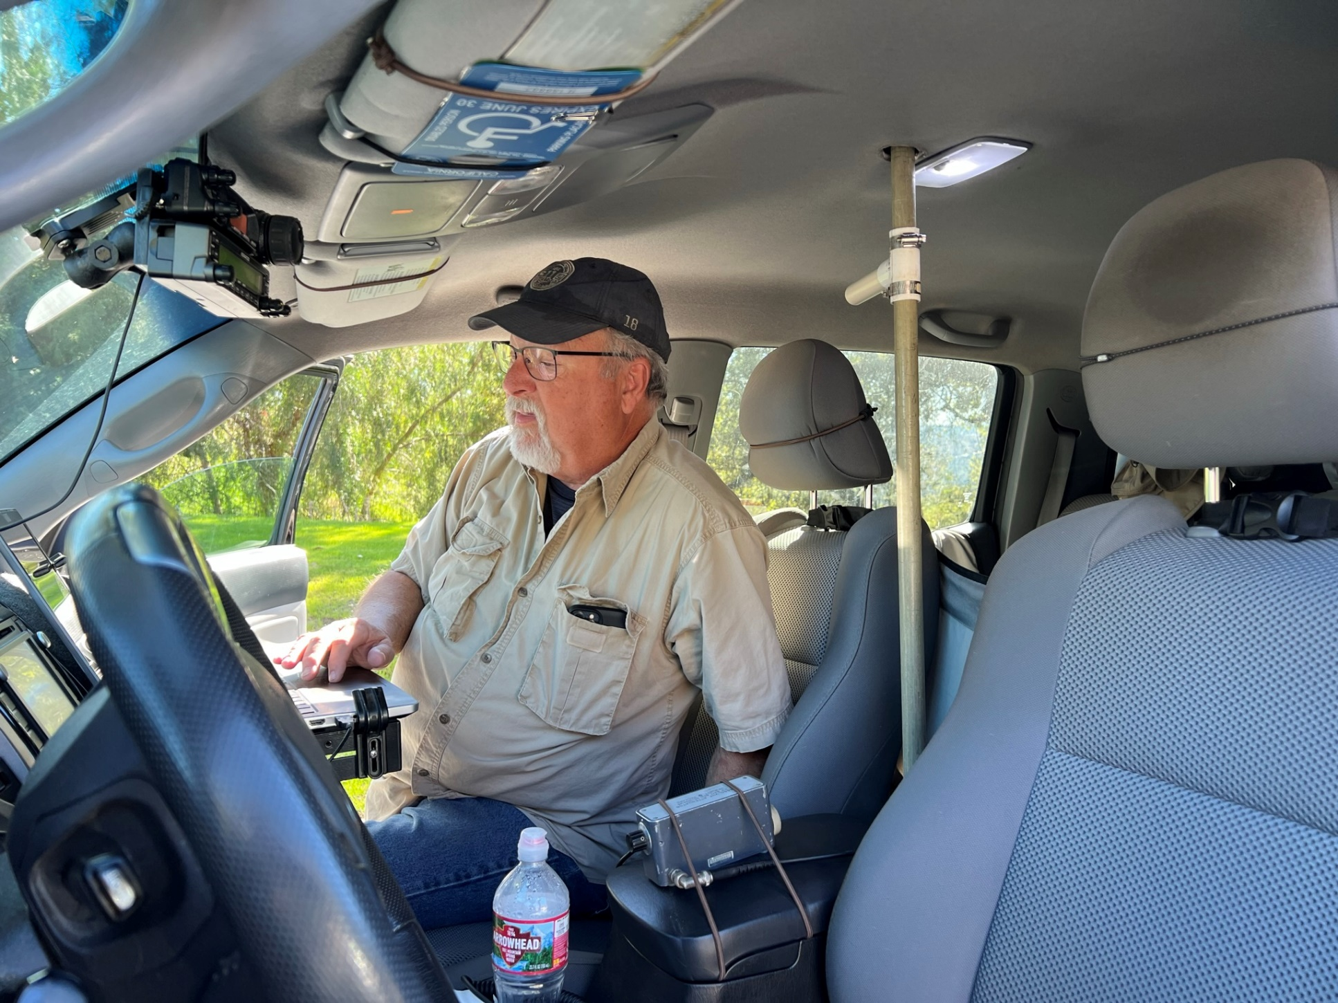
2026

Slide 16
Attenuators

Slide 17
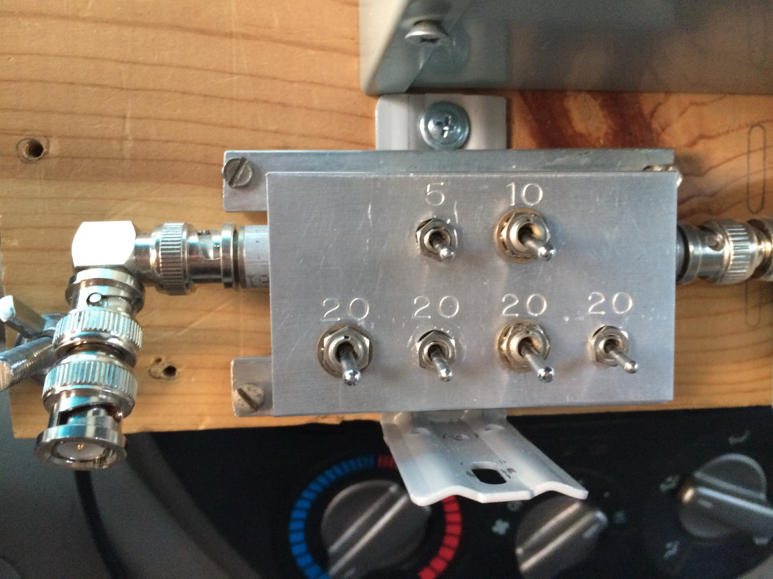

Slide 18
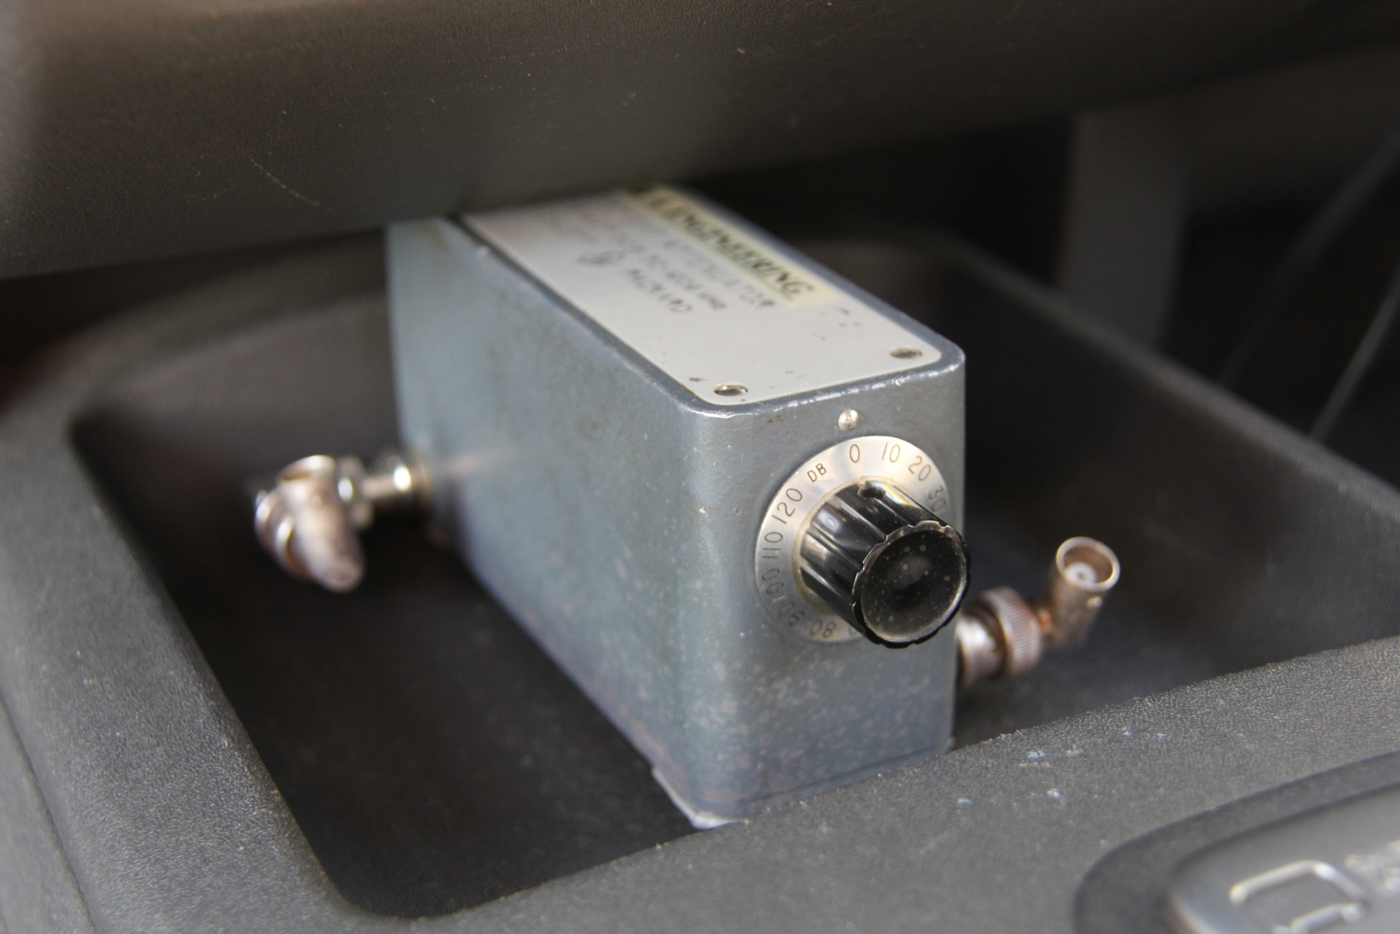

Slide 19
Mobile antennas

Slide 20
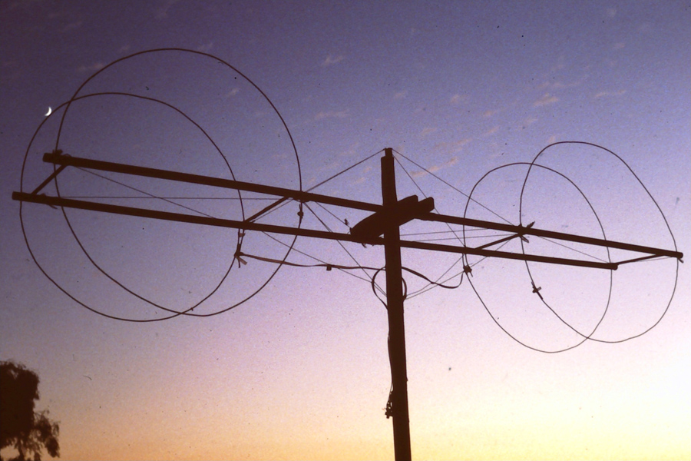
1988

Slide 21
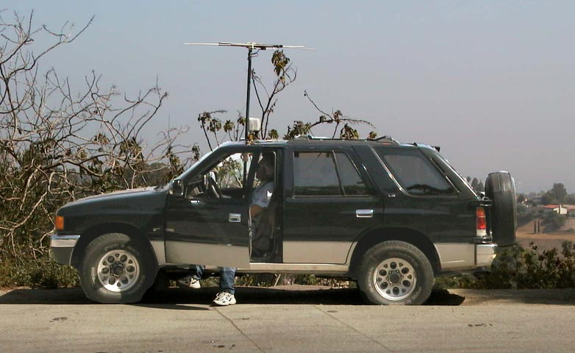
2000

Slide 22
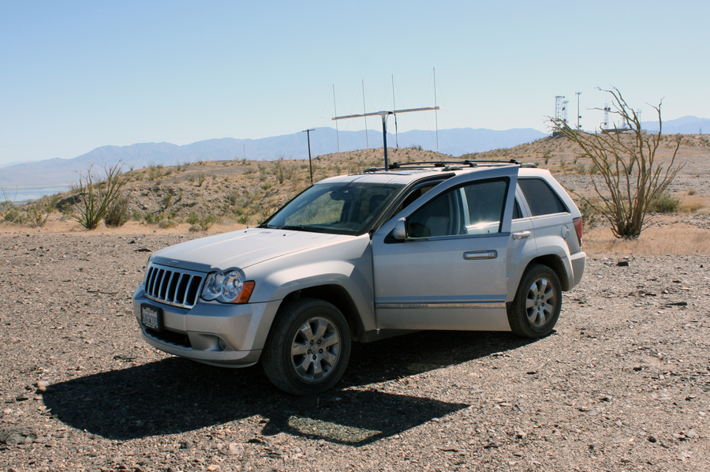
2011

Slide 23
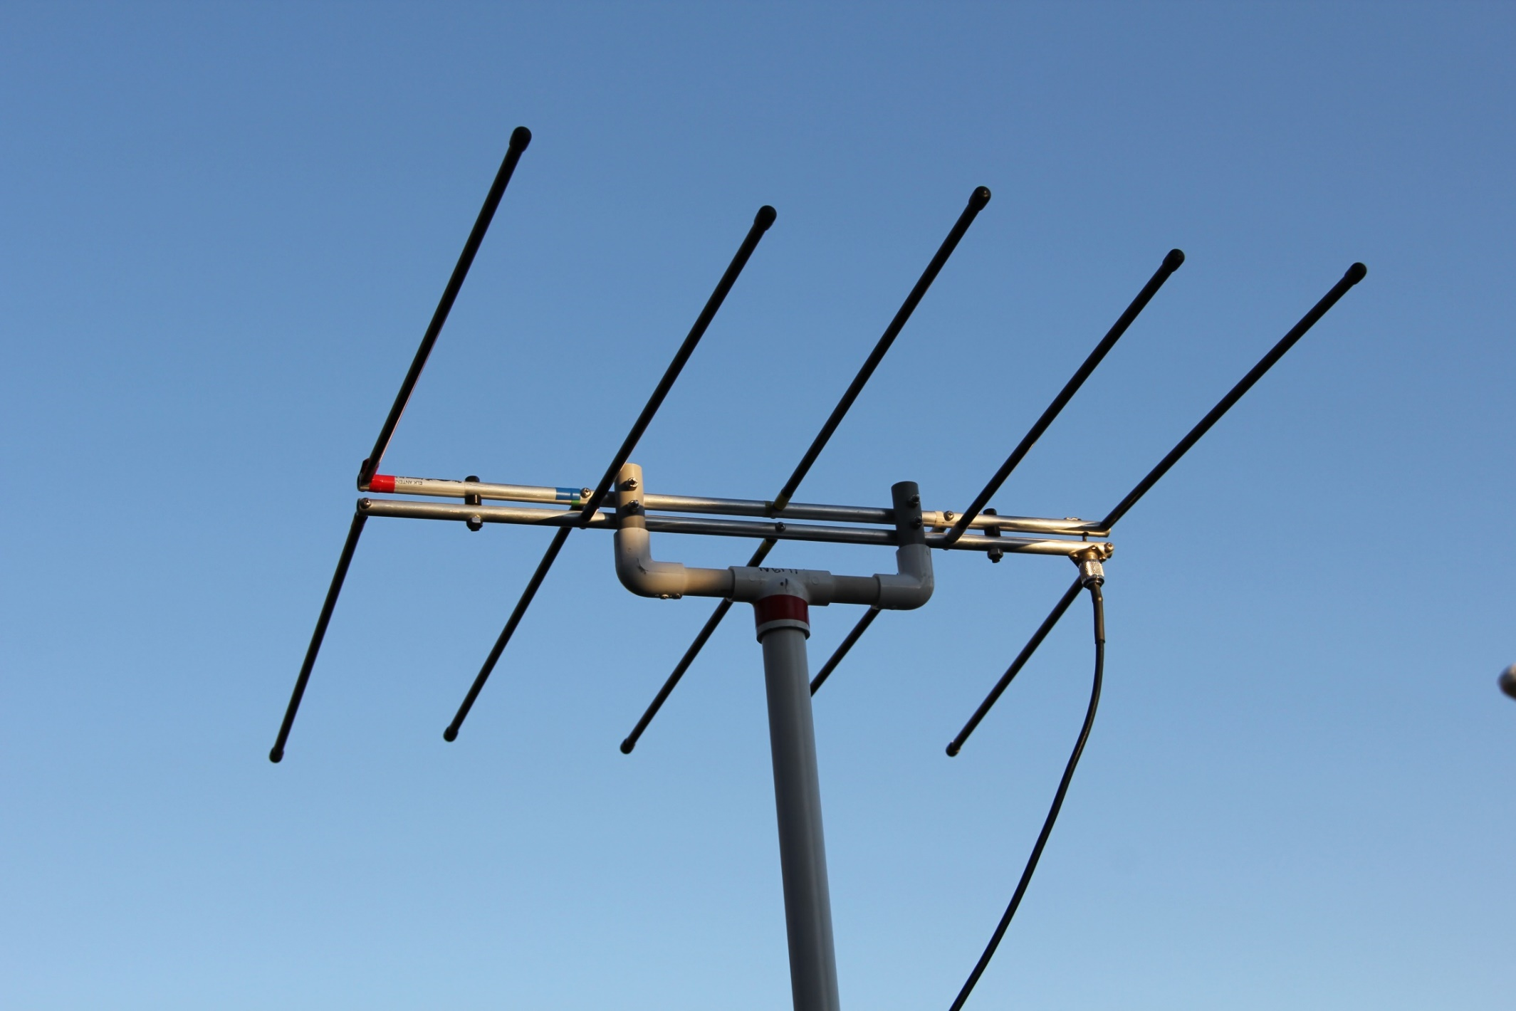
2019

Slide 24
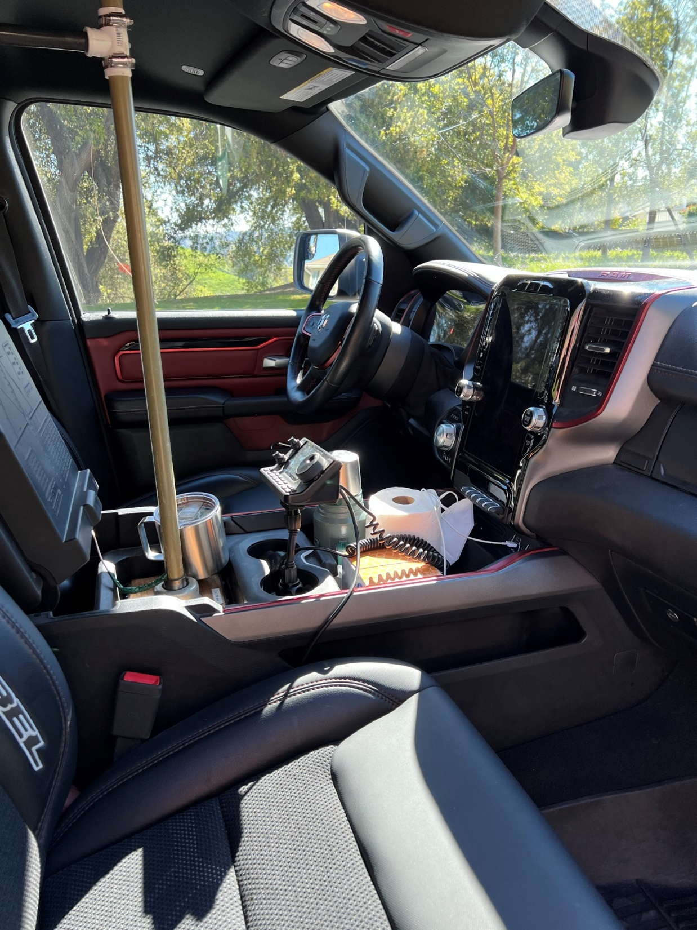
2026

Slide 25
The hole in the roof
(it only hurts a little)

Slide 26
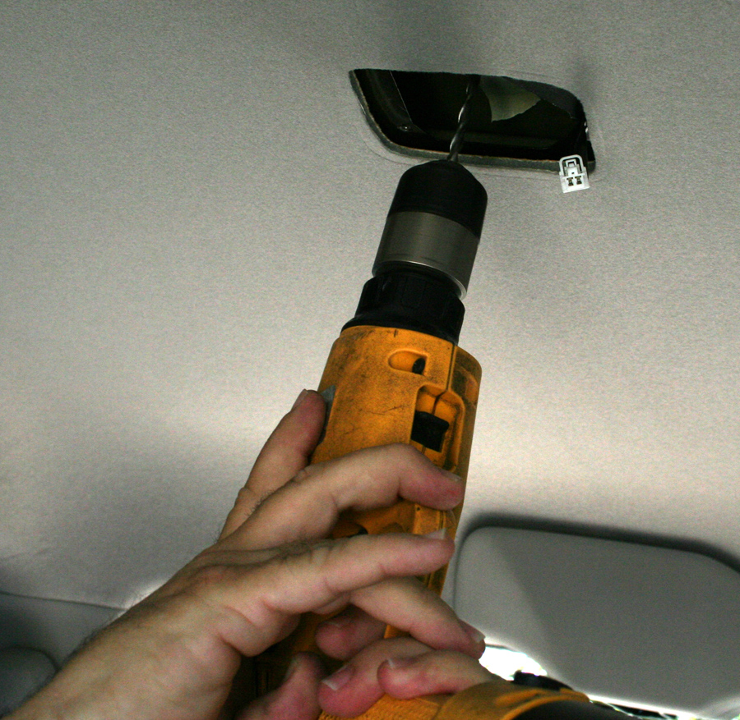

Slide 27
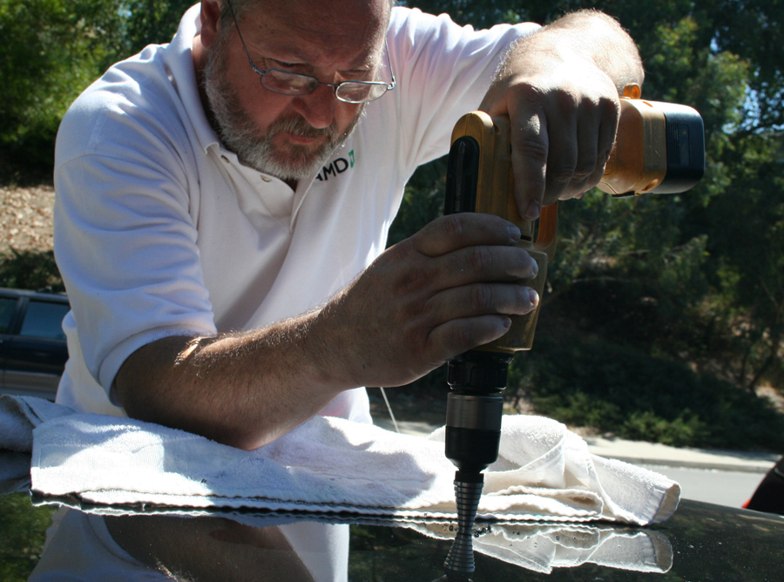

Slide 28
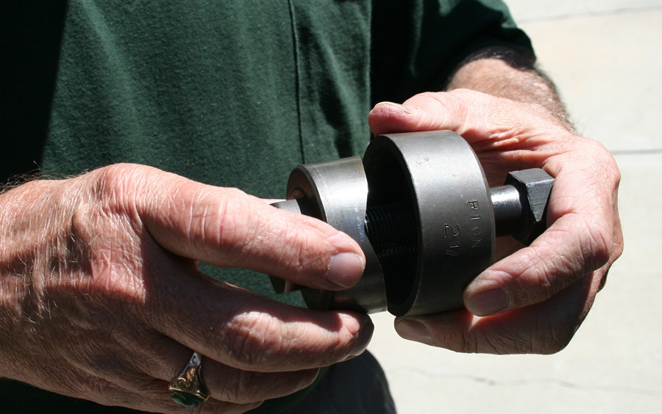

Slide 29
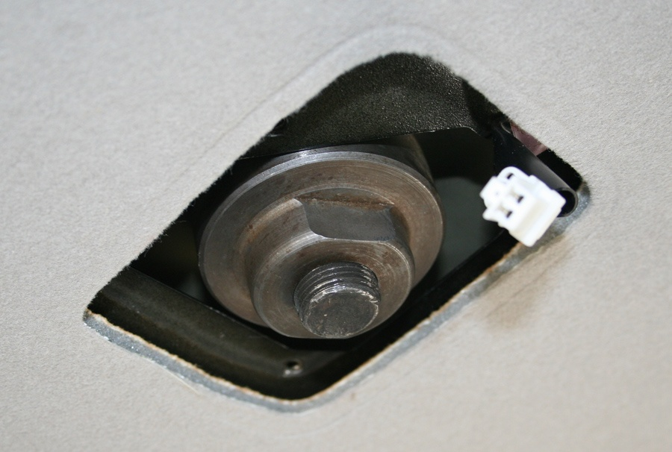

Slide 30
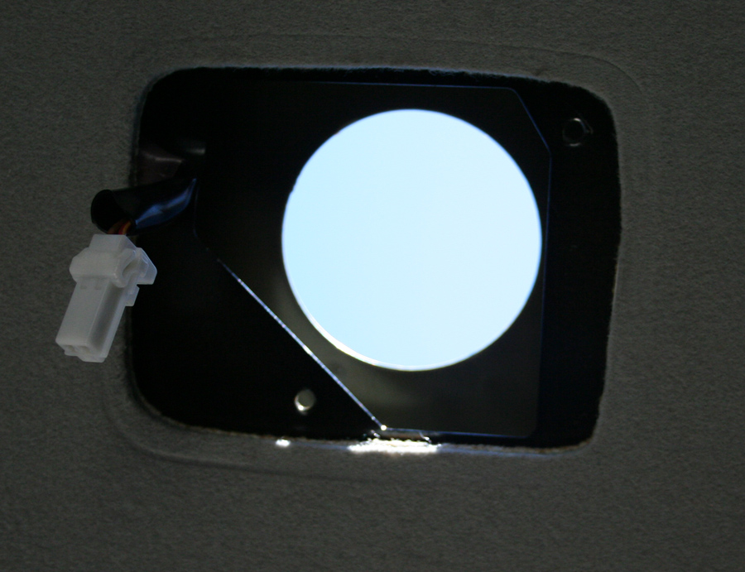

Slide 31
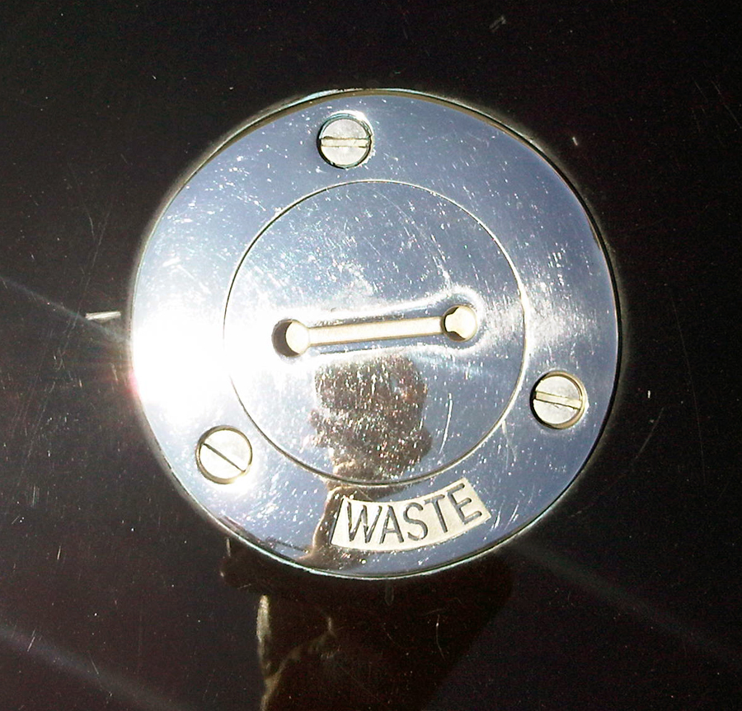

Slide 32
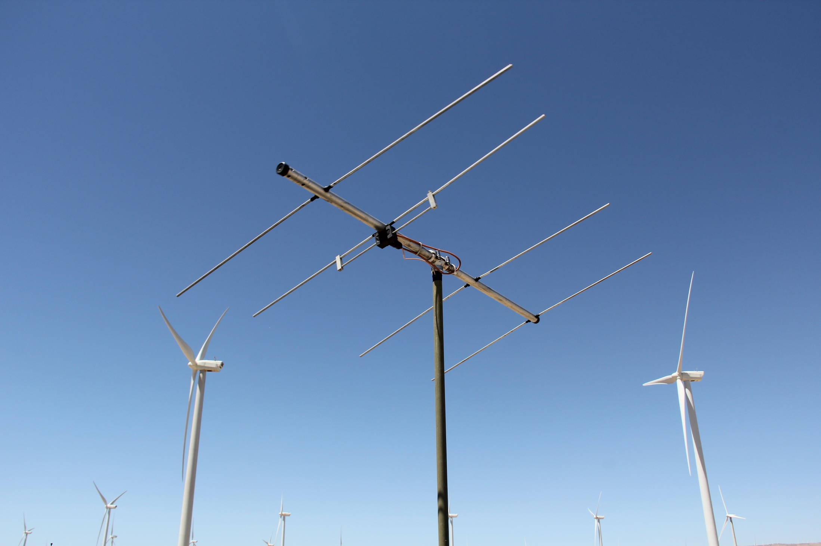

Slide 33
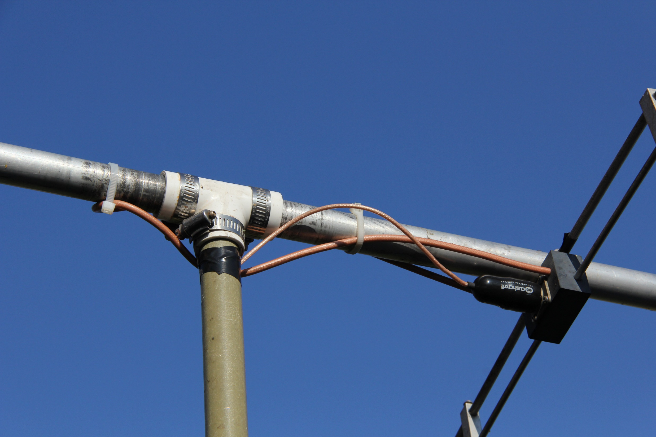

Slide 34
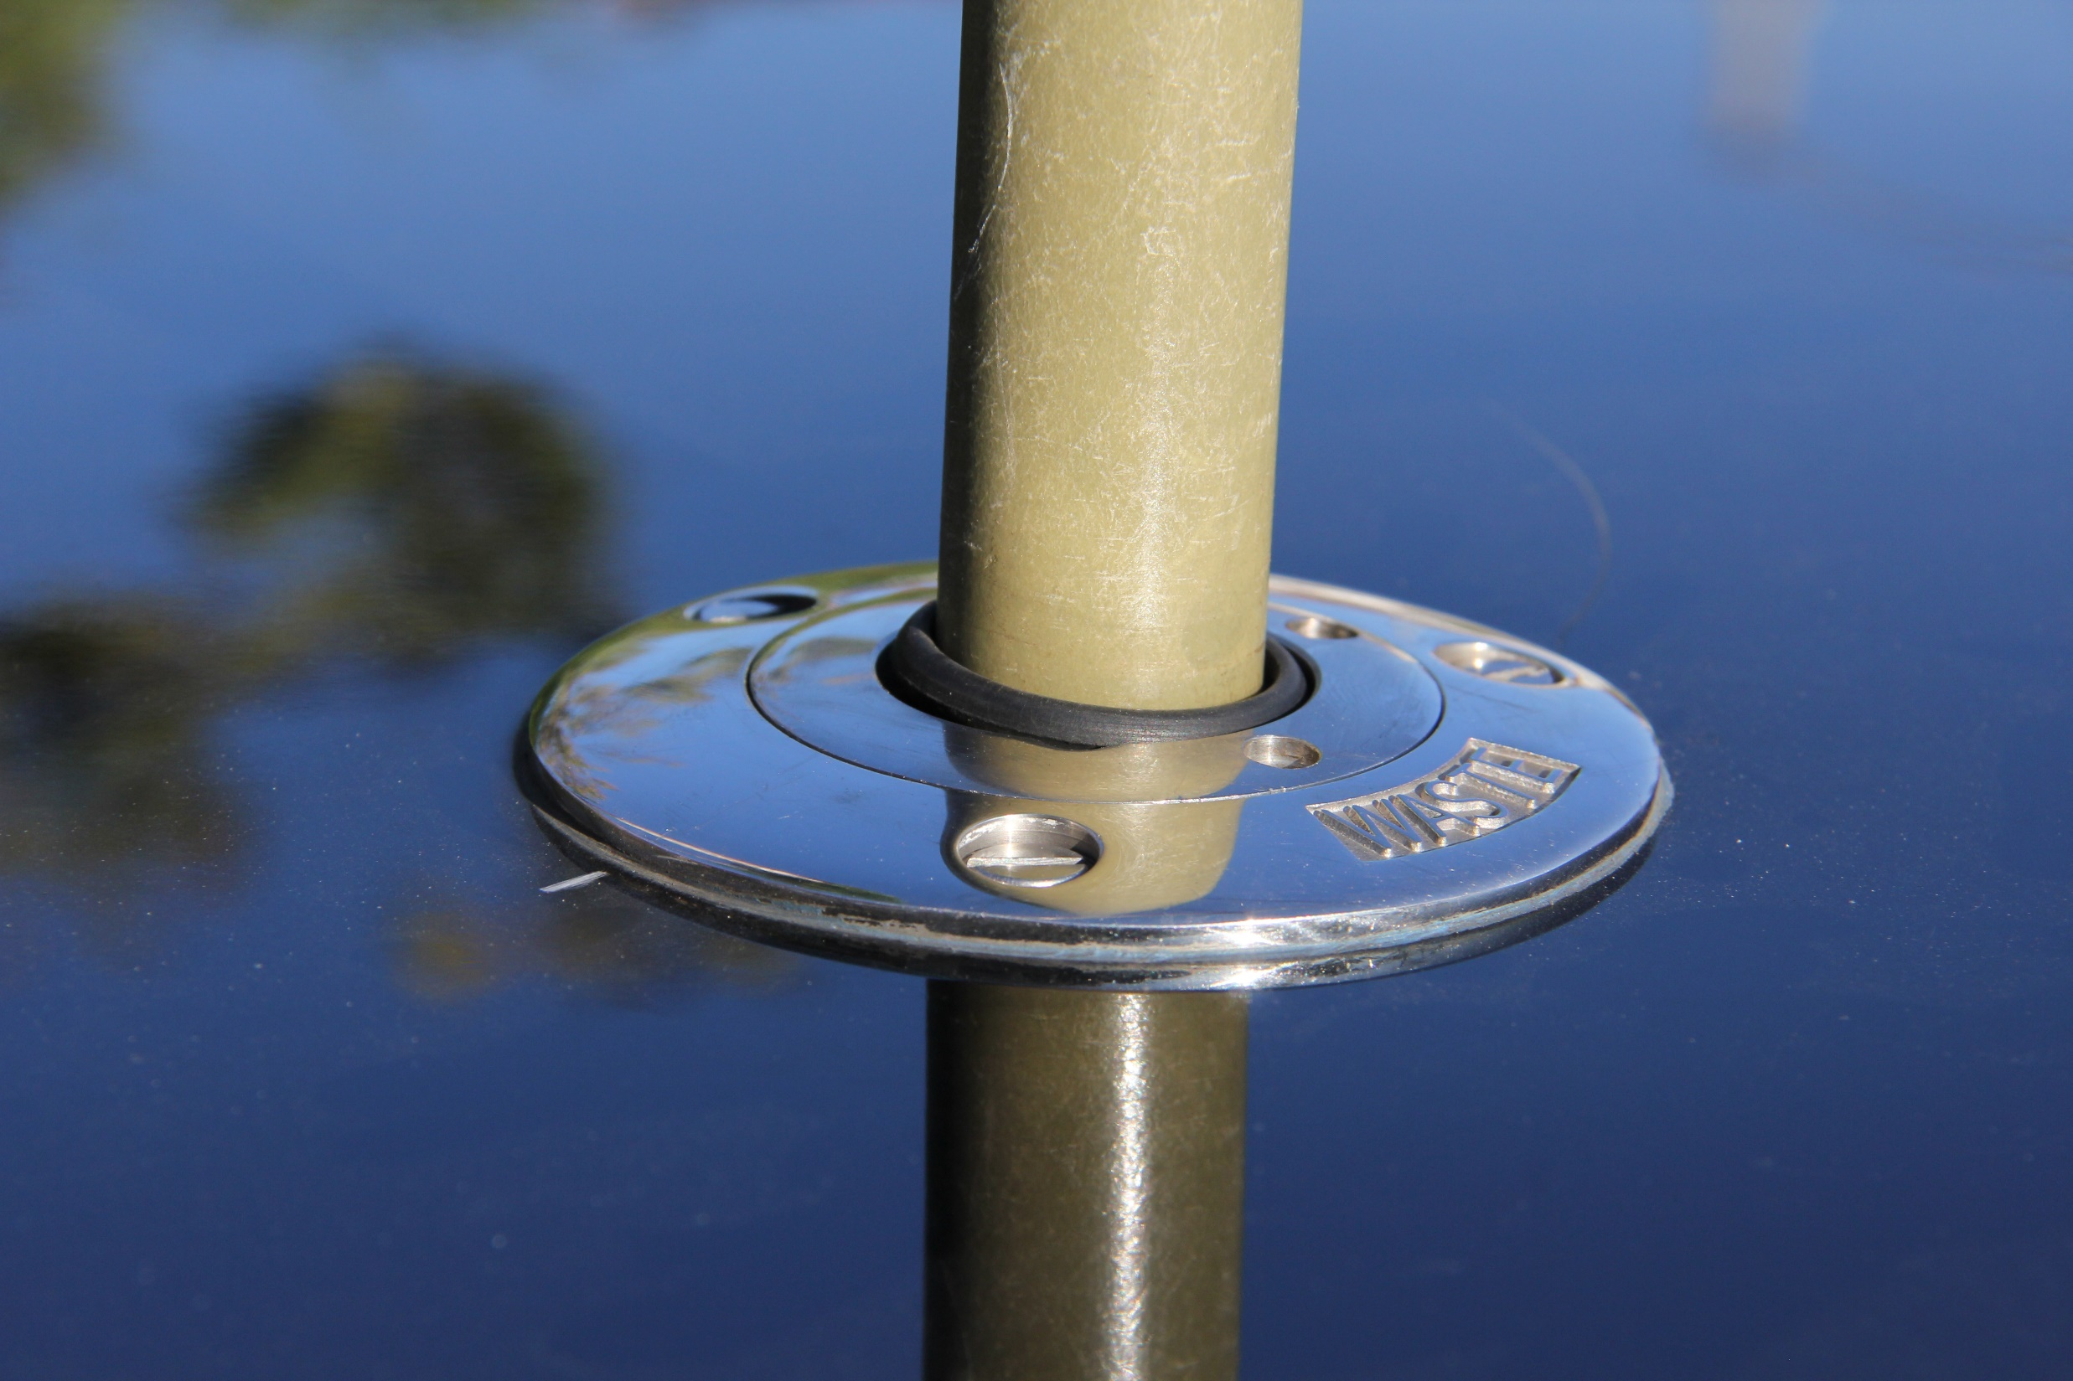

Slide 35
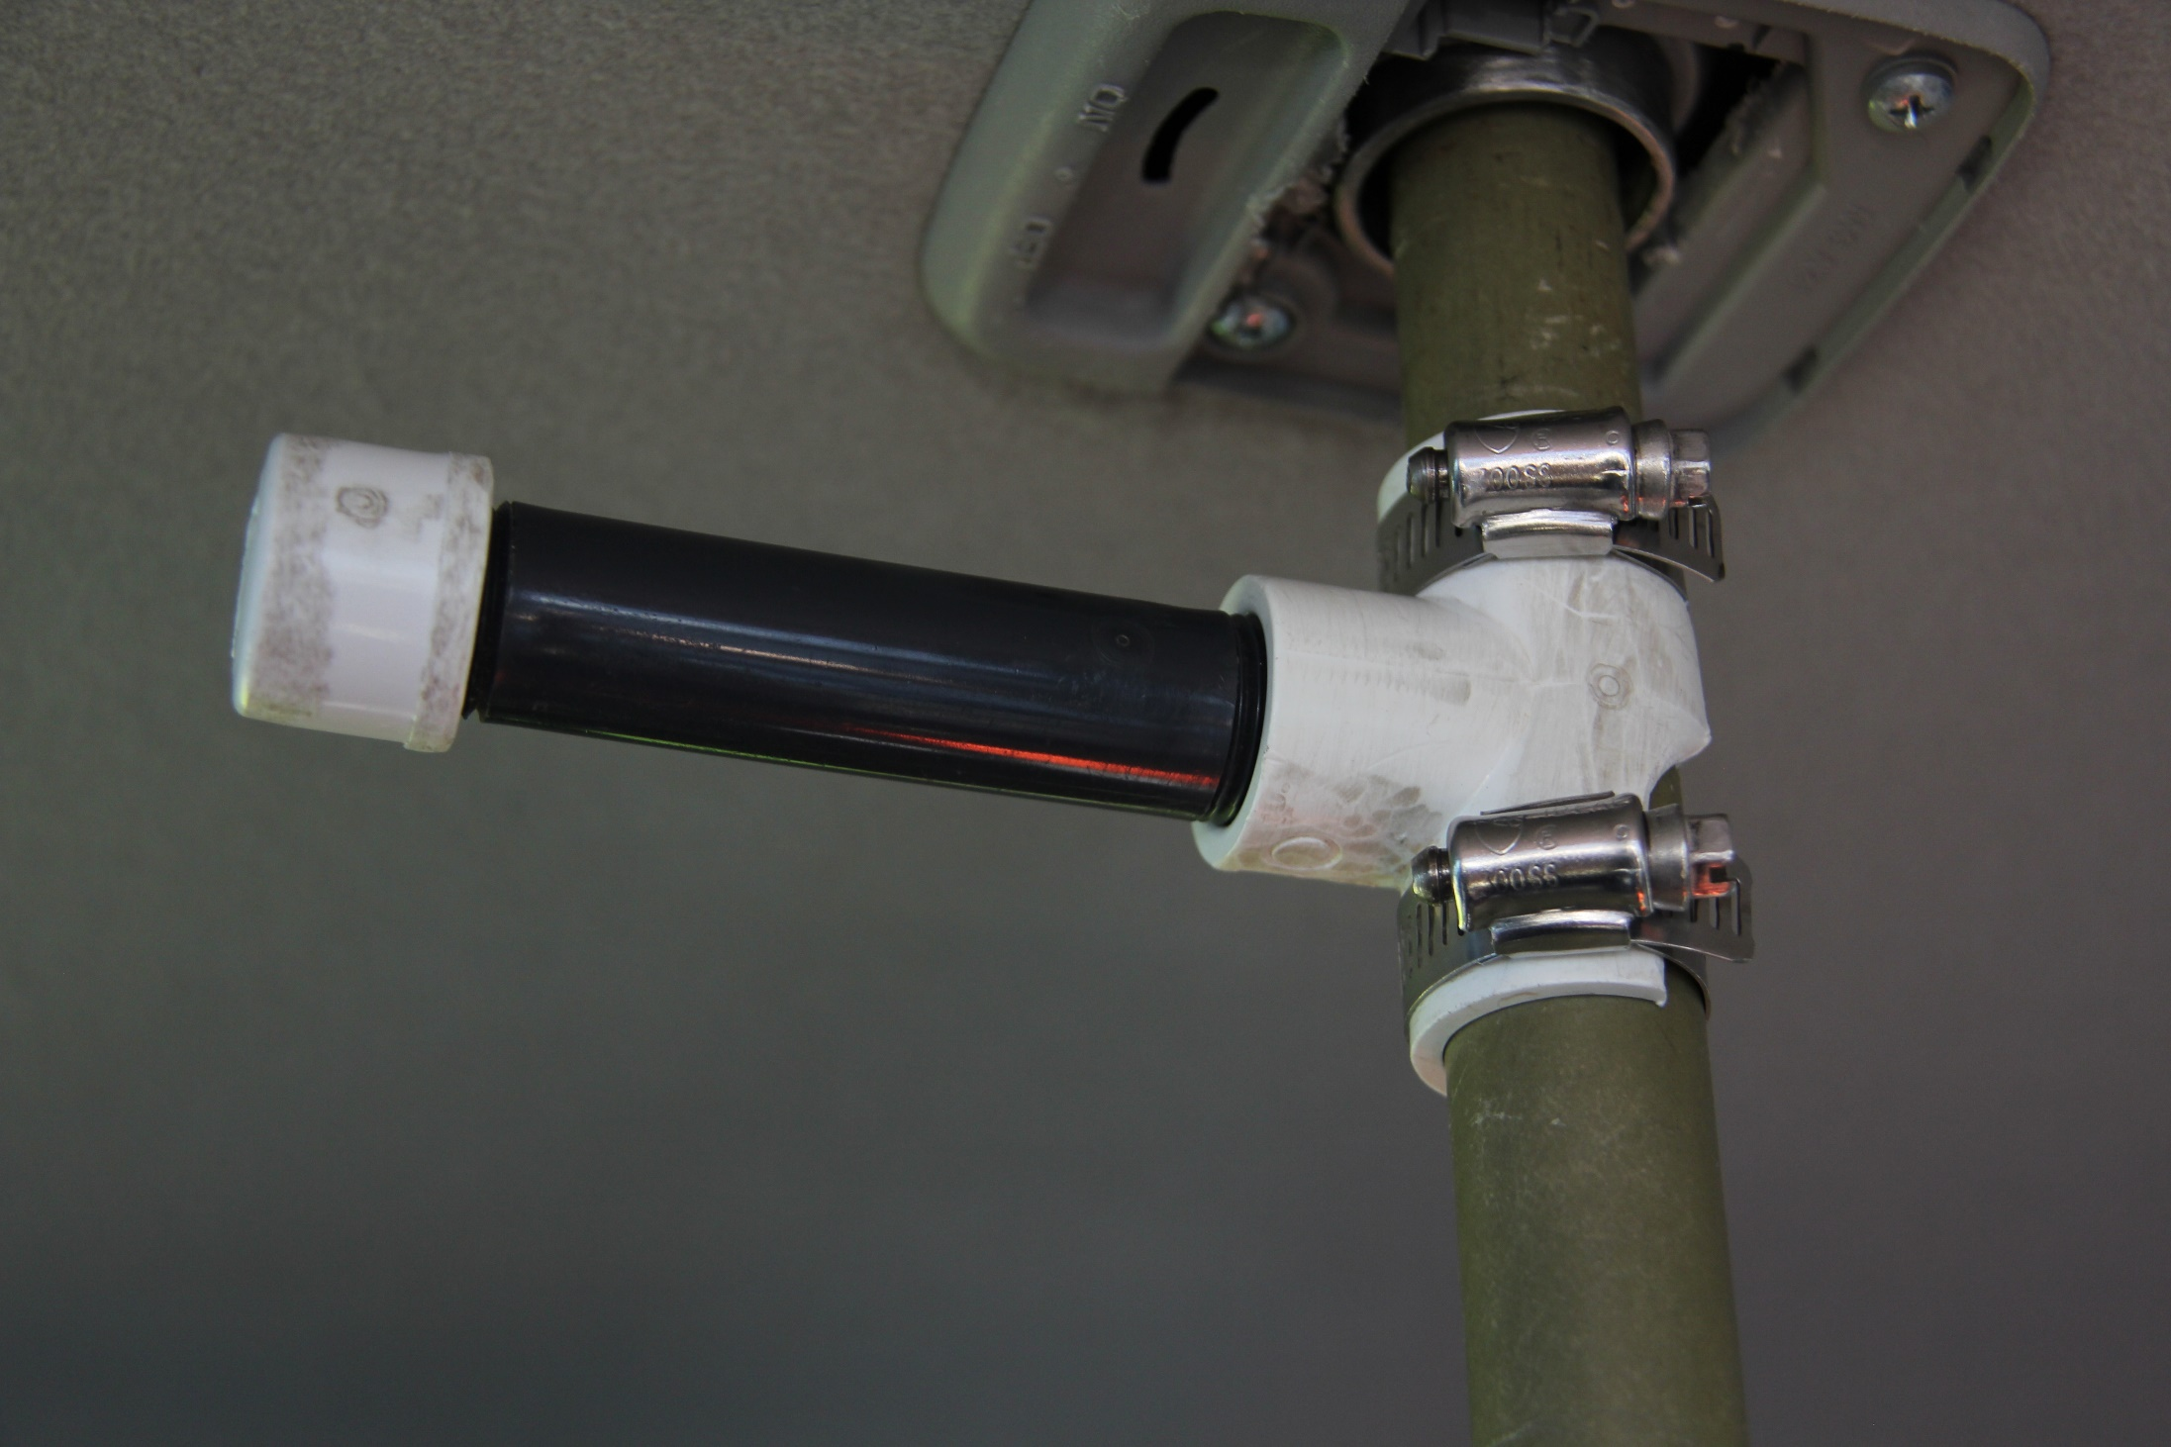

Slide 36
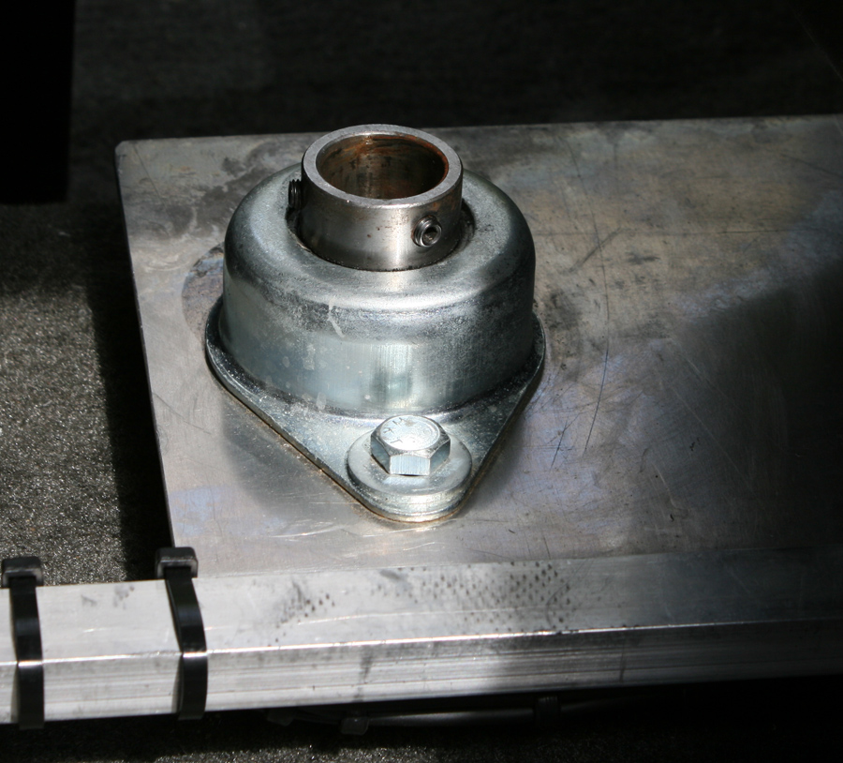

Slide 37
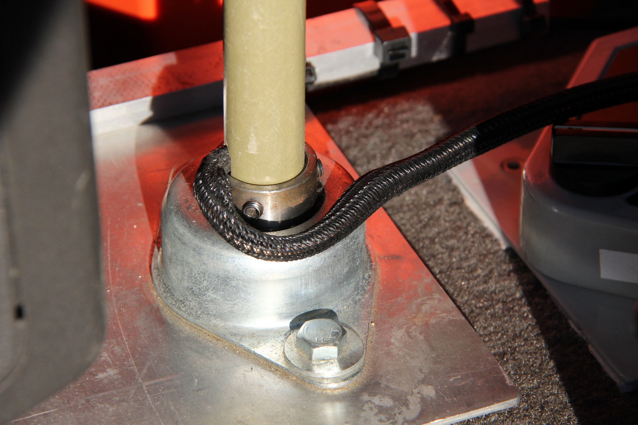

Slide 38
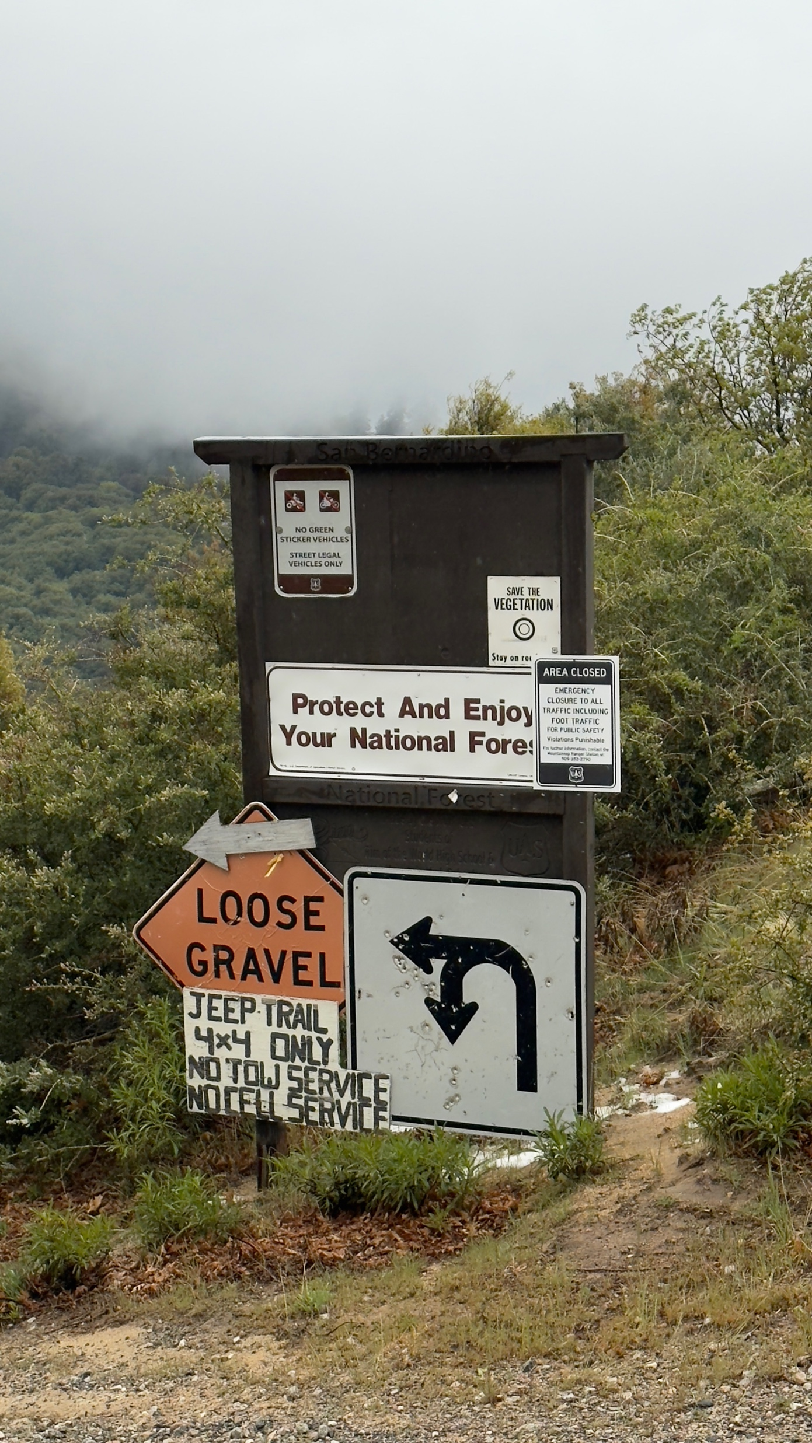
Vehicles

Slide 39
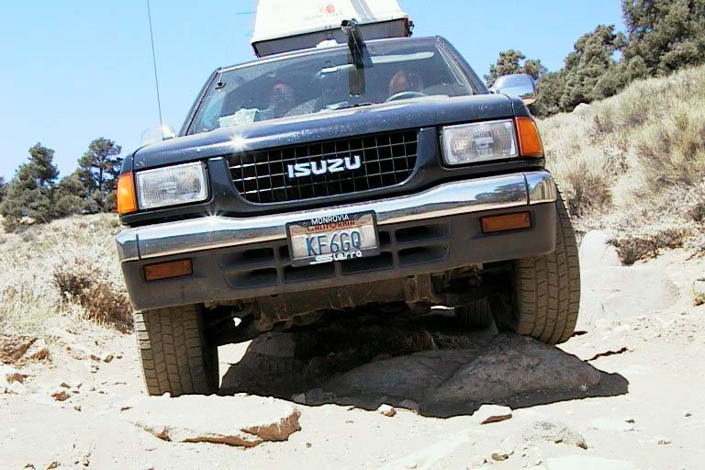
1998

Slide 40
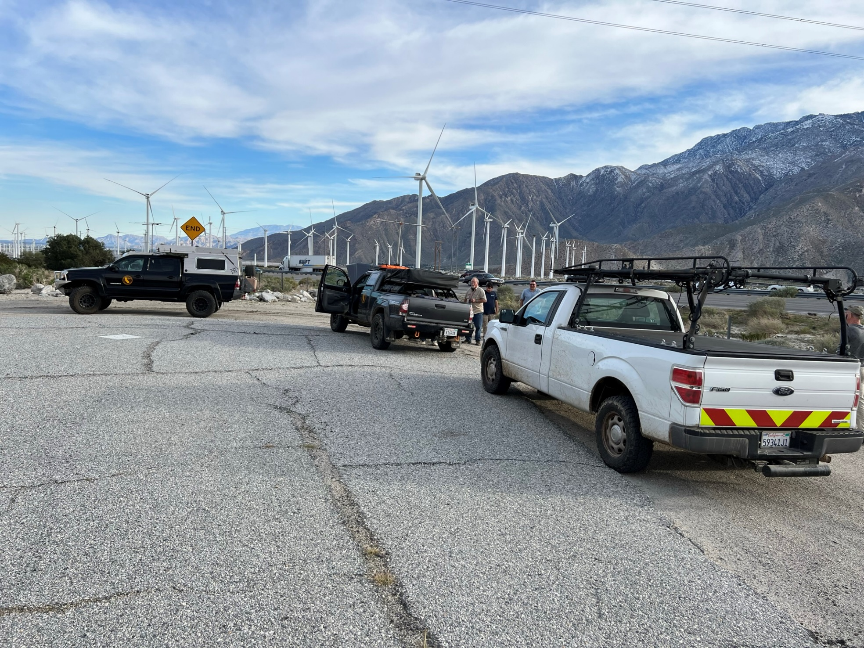
2022

Slide 41
Navigation

Slide 42
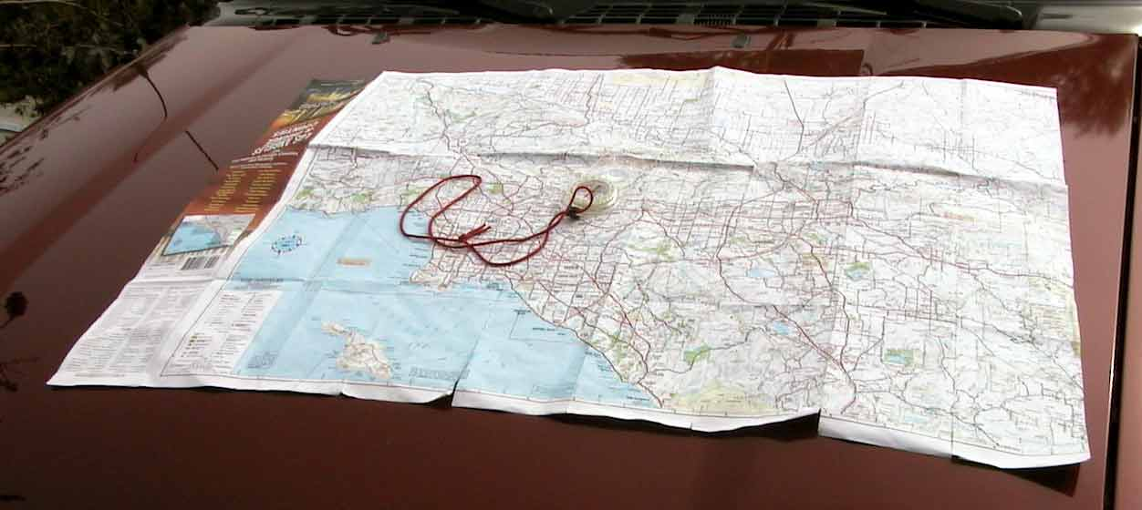
Map and compass

Slide 43
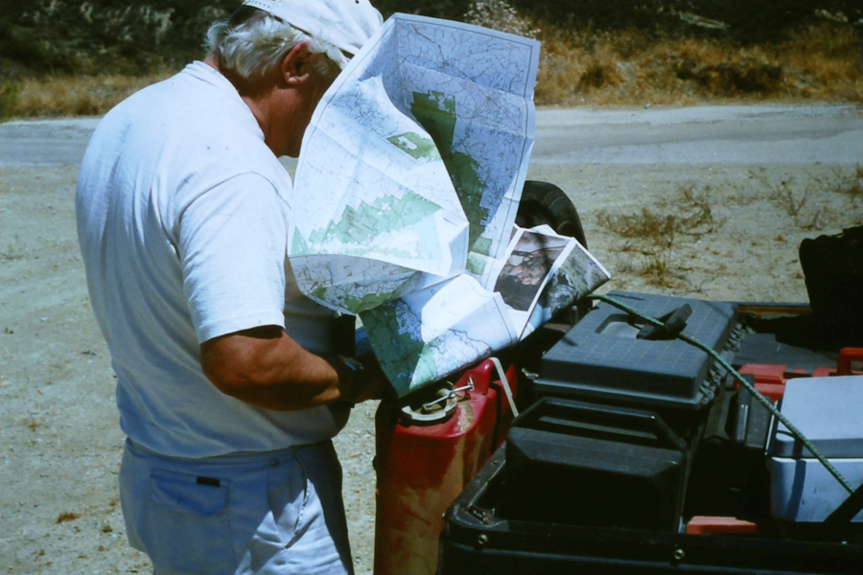
1988

Slide 44
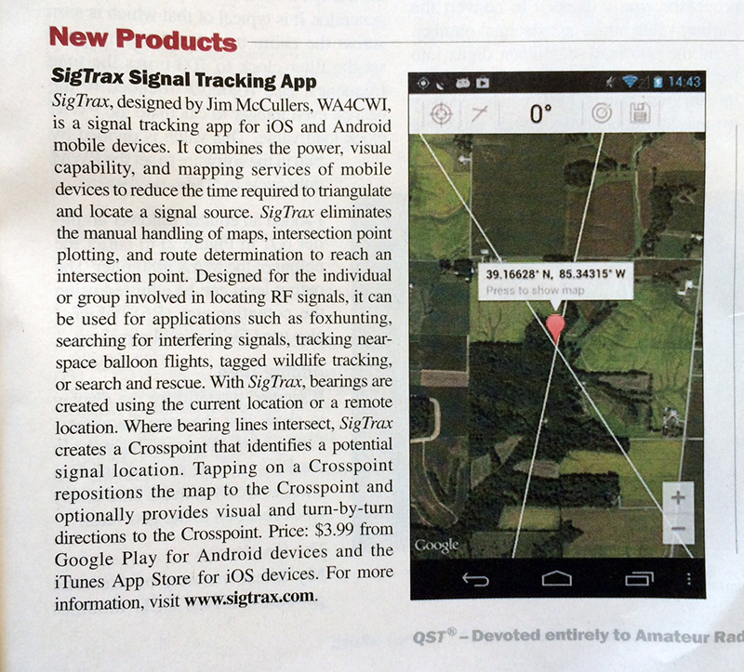
2016

Slide 45
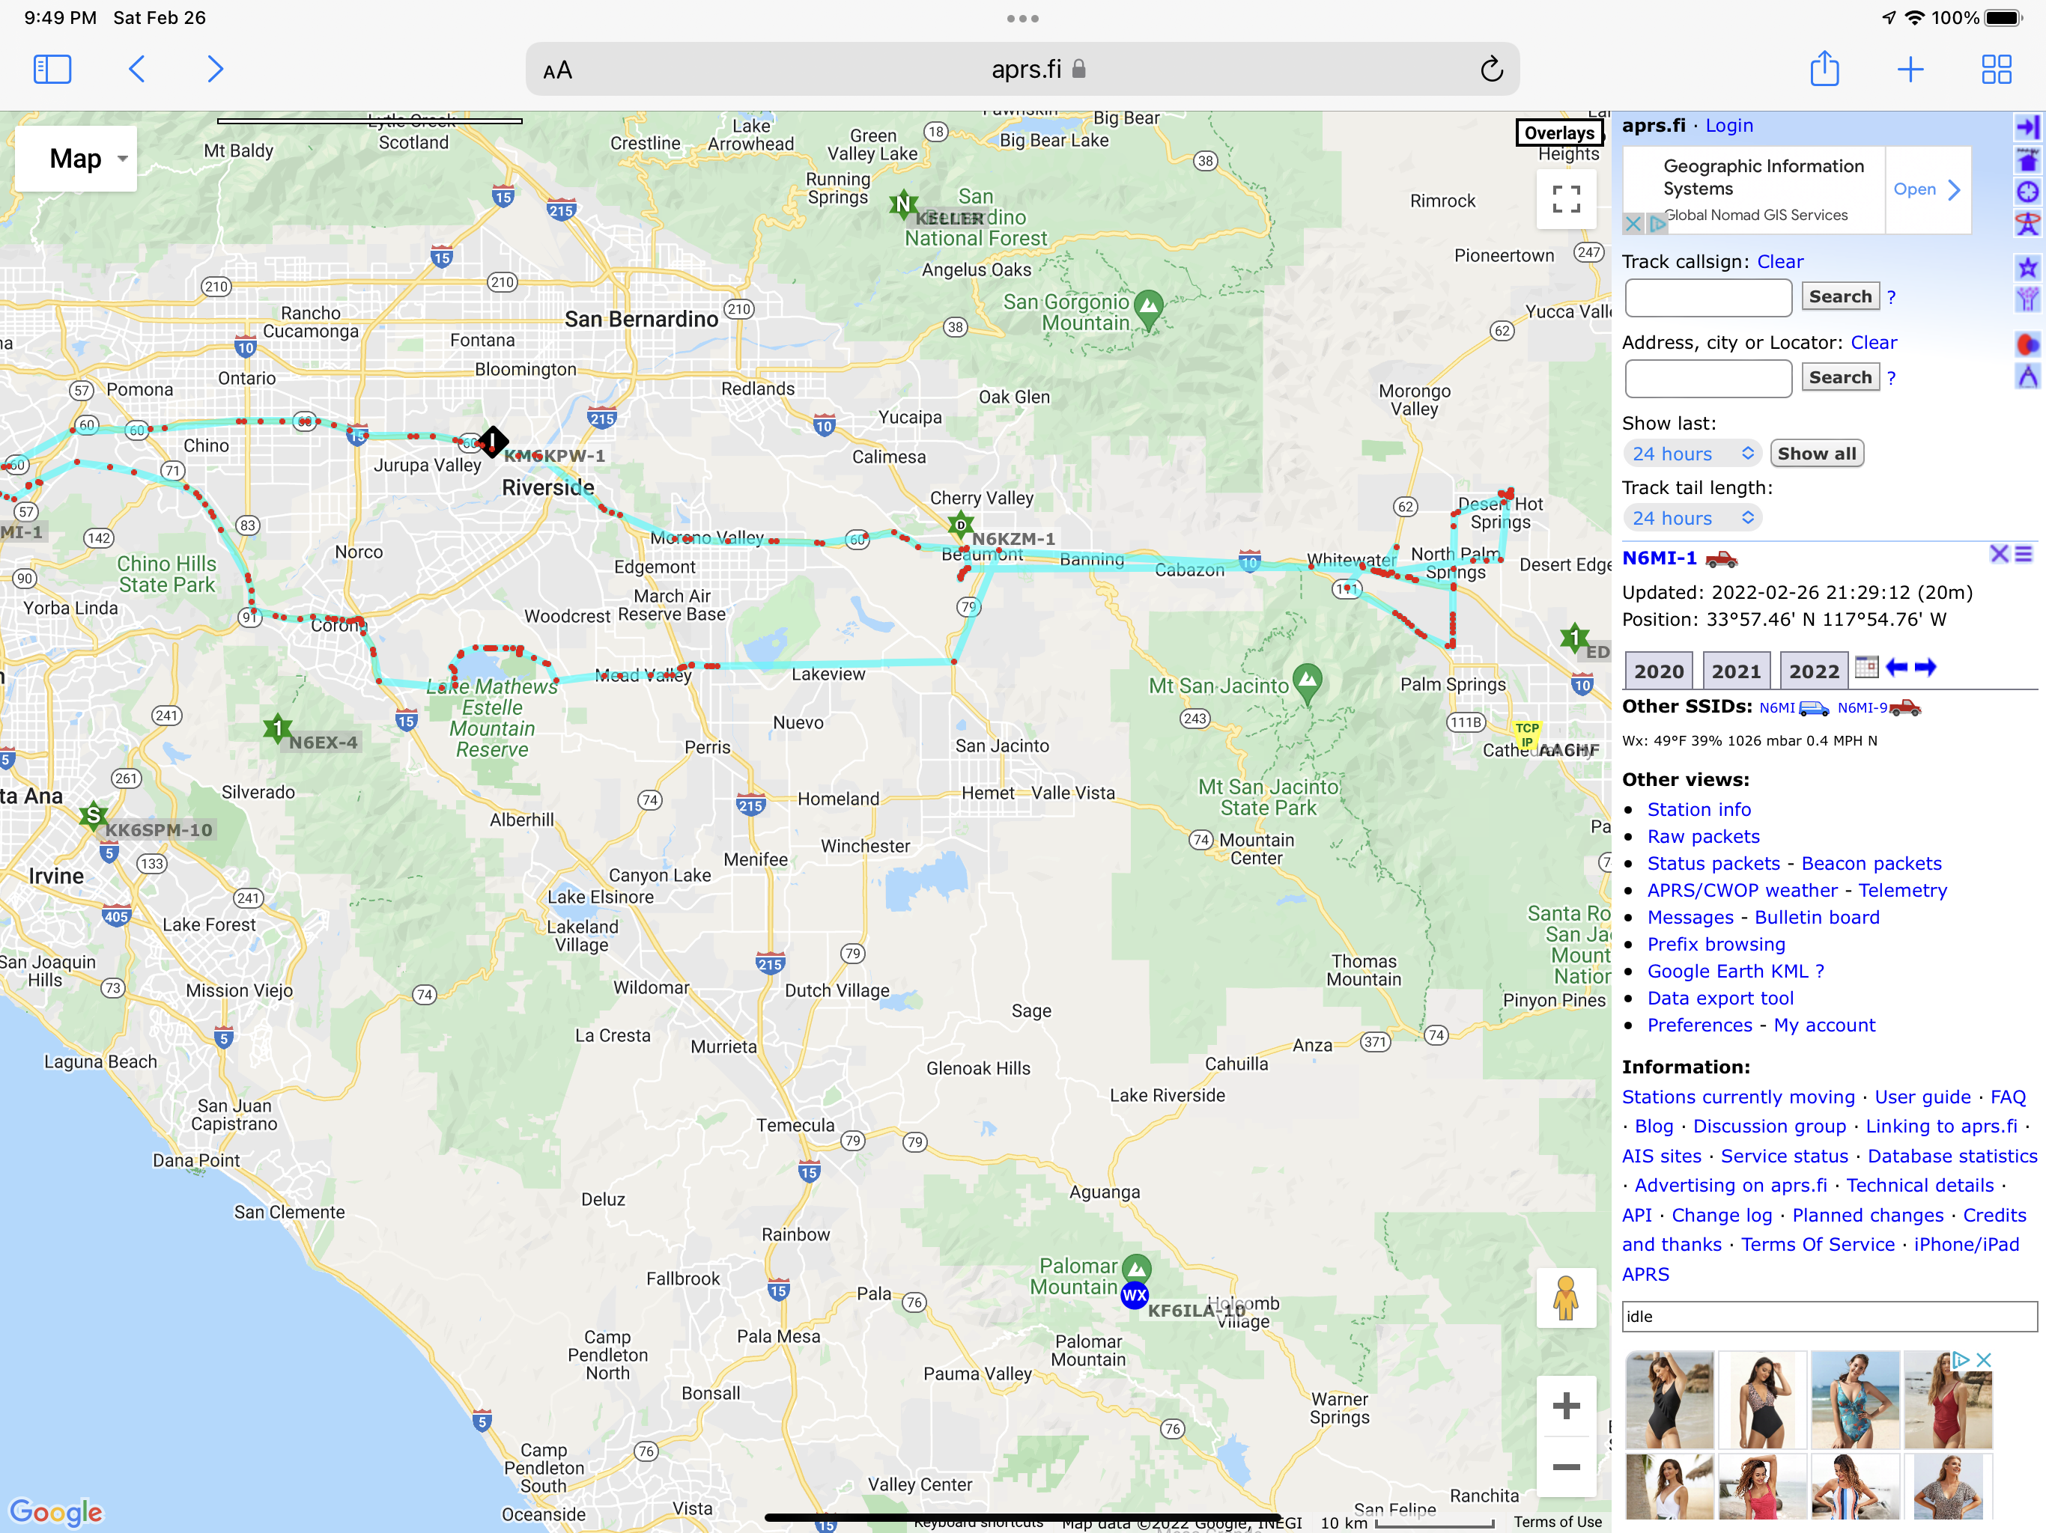
2026

Slide 46
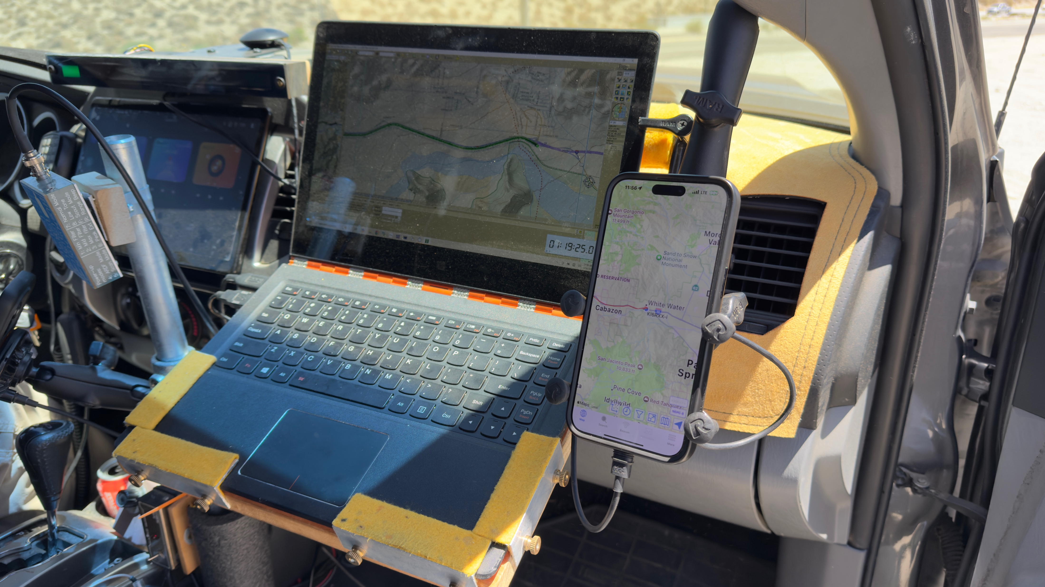

Slide 47
Roads

Slide 48
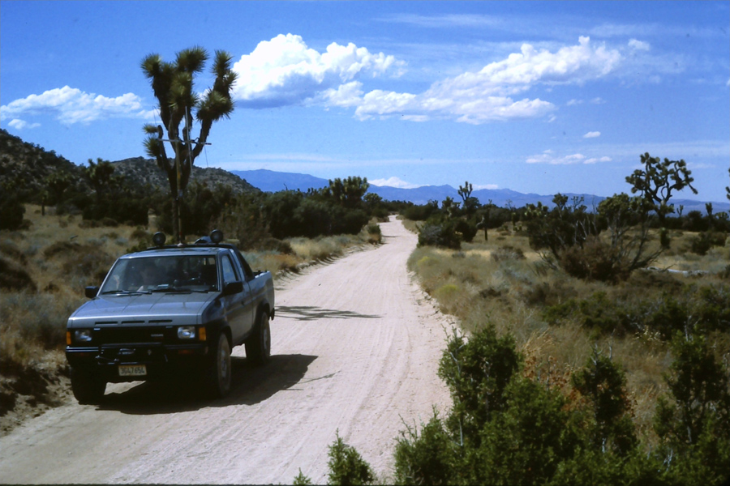
1987

Slide 49
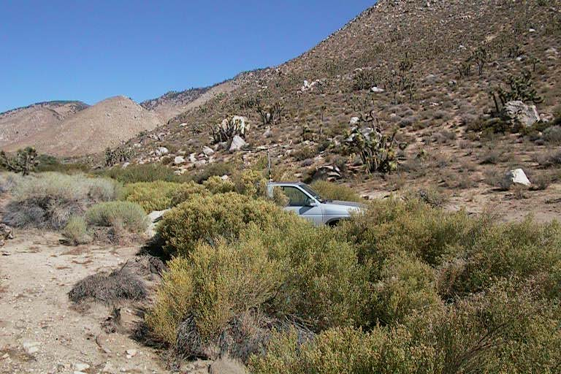
1997

Slide 50
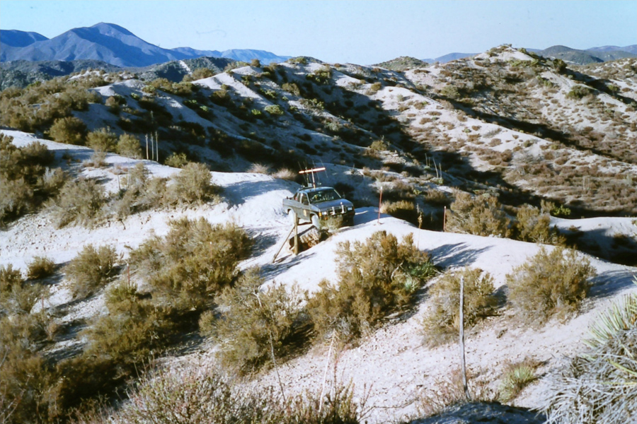
1999

Slide 51
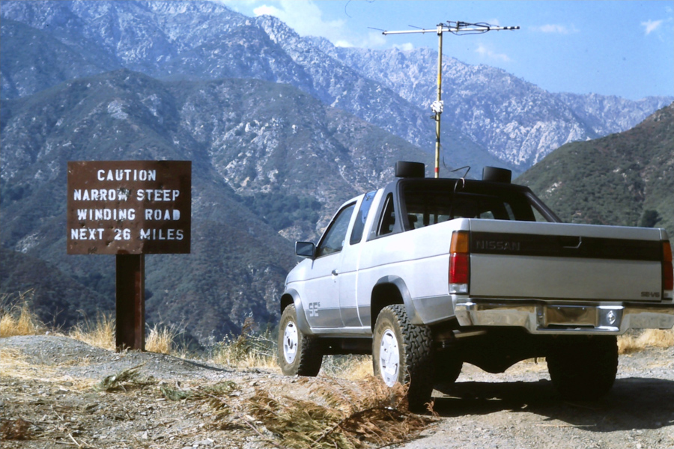
2001

Slide 52
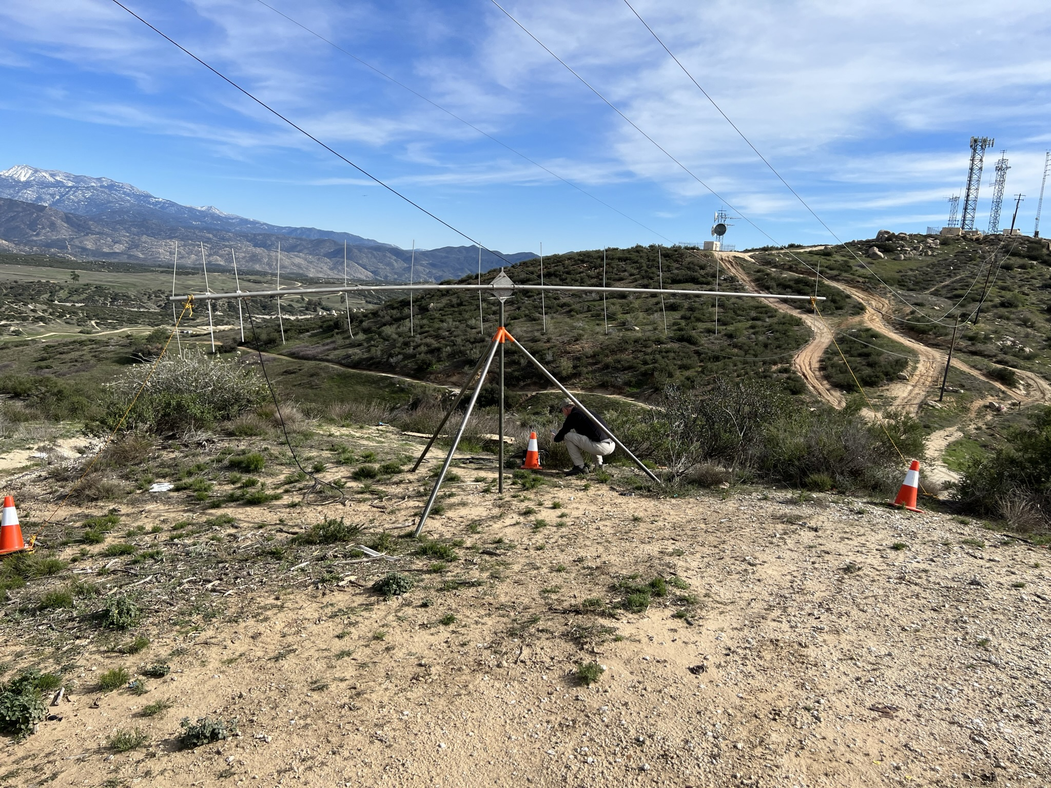
2022

Slide 53
Hidden transmitters

Slide 54
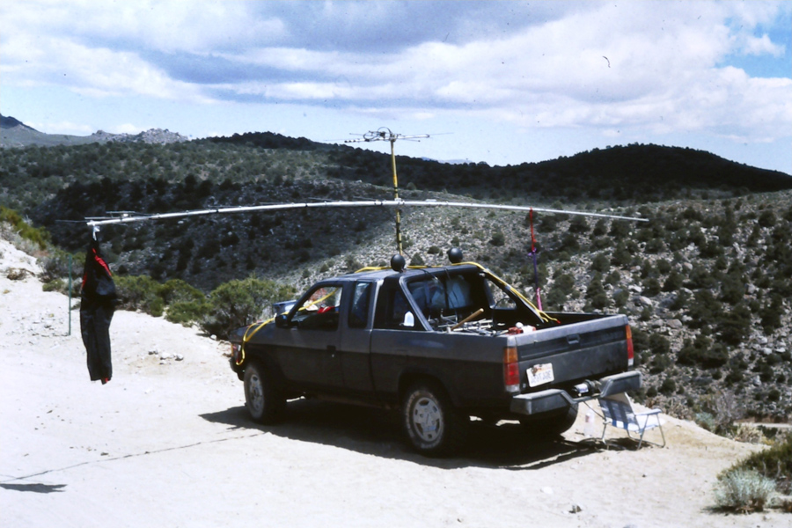
1992

Slide 55
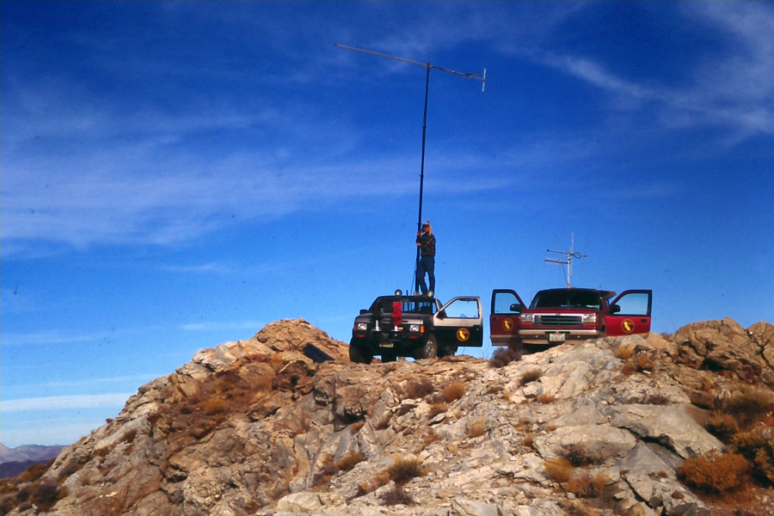

Slide 56

2000
KD6LAJ
KF6GQ

Slide 57

1995

Slide 58


Slide 59


Slide 60

1997

Slide 61


Slide 62

2012

Slide 63


Slide 64

2014

Slide 65

2014

Slide 66


Slide 67


Slide 68



byonics.com

Slide 69



Slide 70


Slide 71


Slide 72


Slide 73


Slide 74


Slide 75
Sniffing

Slide 76

1863

Slide 77


Slide 78

2022

Slide 79


Slide 80


Slide 81
Sign in sheet

Slide 82


Slide 83


Slide 84

2022

Slide 85
Personalities

Slide 86

K6VCR

Slide 87

WA6RJN

Slide 88

WB6HPW – N6PL will often navigate

Slide 89

KI6RXX AF6O

Slide 90

new.thunter.org
n6mi.com
W6PNG
Paul

